Slide 1
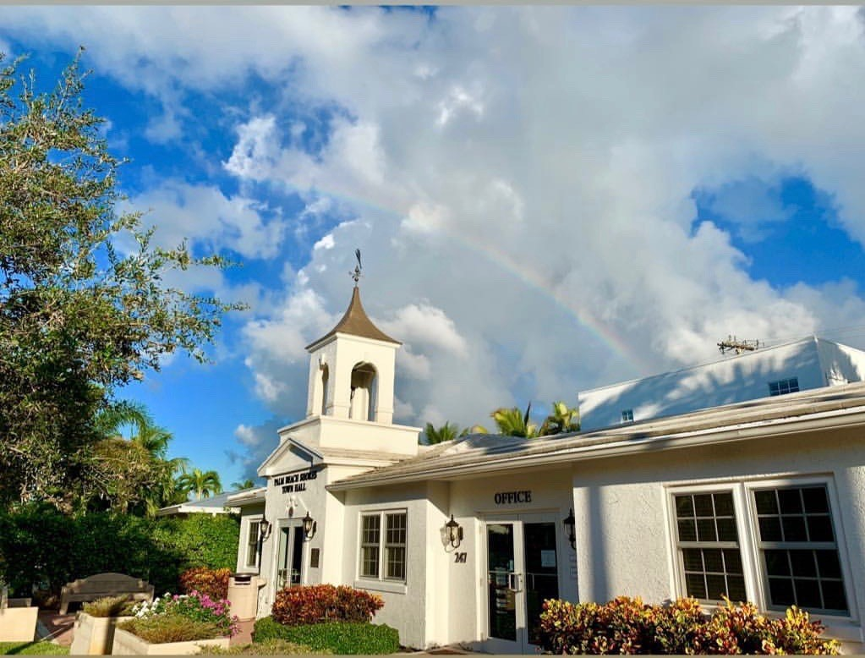
2019 State of the Town Address
Mayor Myra Koutzen

Slide 2
Town Commission Vice Mayor Roby Dereuil Commissioner Gil Gilgallon, Commissioner Bob Stanton Commissioner Brian Tyler (No Election in March)

Slide 3
Planning & Zoning Board
Chair Janet Kortenhaus-Salmon
Jerry Cohn
Nina Lammert
Mary Stanton
Rick Zeigler
Alternates Joan Grody-Bancroft, Debi Culotta
At Least One Position Opening in 2019

Slide 4
Town Senior Staff
Police Chief Steve Langevin
Fire Chief Trevor Steedman
Public Works Director Alan Welch
Town Clerk Evyonne Browning
Town Treasurer Wendy Wells

Slide 5
Police Staffing
Chief Steve Langevin
Sergeant Mike Simmons
Sergeant Blasé Pfefferkorn
Investigator Darrell Russian
Background Checks and Internal Affairs Investigator Tony Sanchez

Slide 6
2018 Accomplishments
Renovated Police Station
Donated Improved Weaponry and Storage
Active Shooter Presentation (Repeating on Saturday Jan 26)
Officer Novella & Quella Re-Certified
Installing Updated License Plate Readers and New CCTV at all Three Town Entrances
One Car Burglar is in jail and the other awaiting trial based on our evidence.
Lock Your Cars, pretty please.

Slide 7
Fire Department Staffing
Chief Trevor Steedman
4 FT Firefighter/Paramedics
20ish volunteers
Volunteer Opportunities

Slide 8
2018 Accomplishments
Improved Training in conjunction with Riviera Beach, North Palm and West Palm Depts
Community CPR/Fire Extinguisher Training and Home Safety Surveys
Instituted Regular Fire Hydrant Testing and Maintenance Program
Donated Portable Pump For Marine Fires

Slide 9
Public Works Staffing
Director Alan Welch
Technician Frank Stuparitz
Technician Andrew Fenton
Volunteer Opportunities

Slide 10
2018 Accomplishments
Freshly Painted Stop Bars/Rumble Strips
Converted 76 Inlet Walkway Lights to LED
Parkway Fountain Restoration
Community Center: New BBQ Grill, Fire Lanes
Renovated Police Dispatch; Hurricane Windows
Improved IT Capabilities & Security
New Town Hall Generator
New Drainage Rocks in Culverts

Slide 11
Town Hall Staff
Town Clerk Evyonne Browning
Town Treasurer Wendy Wells
Assistant Clerk, Webmaster & Office Manager Gaudy Quesada
Community Center Coordinator, Building Department & Accounts Payable
Laura Brown
Building Official Sal Massaro (Safebuilt)
Code Enforcement Officer
Orlando Rodriguez (Safebuilt)

Slide 12
2018 Accomplishments
New Bank Improving Service and Income
Processed unprecedented volume
of building permits (again)
Staff-wide sexual harassment training
Another Clean Financial Audit
Revised Employee Handbook

Slide 13
Consultant Partners
Town Attorneys Keith Davis, Mitty Barnard
Labor Attorney Jeff Pheterson
Bond Counsel Mark Raymond
Town Engineer Rob Rennenbaum
Undergrounding Engineer Danny Brannon
Town Planner Josh Nichols
IT Support EssentialNet Solutions
Riviera Beach Utility District, Fire/Rescue EMS
Bass Landscaping
Safebuilt Building Official, Code Enforcement

Slide 14
Teamwork Residents Commission P & Z Staff Consultant Partners
Notes:
Legal, Engineer, City Planner, Code Enforcement, Building Official, Grant Writer, Undergrounding Engineer, Bond Counsel, Auditor

Slide 15
Hurricane Preparedness
Year and a Half Later, We Are Still Filling Out FEMA Paperwork for $350,000 of Irma Damage
Significant damage to Community Center, beach bathroom, inlet seawall, storm drains and sanitary sewer lines
Dry run with County Emergency Center each Spring
Full Town plan updated each year
Improved Police Station Weather Resistance
Working with County and Army Corps to complete inlet seawall and walkway restoration

Slide 16
Six Campaign Priorities
Communications and Transparency
Live Within Our Financial Means
Ensure Public Safety and Quality of Life
Maintain Our Infrastructure and Beautify Our Town
Balance Small Town Friendliness with Professional Reliability
Build Strong Bridges With Our Neighbors

Slide 17
2019 Projects
Continue St Patrick’s Day Parade
Undergrounding Utilities Project
Riviera Beach Water Main Replacement
Continued Police and Fire Station Renovations
Replace Lake Drive Lift Station Generator
Continue to Update Town IT Capabilities/Security
3 Police Cars, 1 Public Works Truck
Improved License Plate Readers/New CCTV

Slide 18
UnderGround Utility Project
Starting this week with installation of main transmission line down Atlantic Ave
Also starting first section of local installations on Linda and Bravado Lanes
Inlet Way and Lake Drive will follow
Properties will be energized as each section is completed

Slide 19
Water Mains
Riviera Beach Utility District
Plan to replace water mains under Lake Drive and Inlet Way. Install connectors to eventually move local mains from behind houses
RB Utility Board approved 2019 project funding
Expecting 60% Plans this month and 6-8 months of work to start late Spring

Slide 20
Town Finances

Slide 21
Property Values Increased 5.4%

Slide 22
Millage Rate Steady at 6.35

Slide 23
Increase Reflects Higher Values

Slide 24
Diversity of Residence Types

Slide 25
Utility Consumption Tax Improves Revenue Diversification

Slide 26
2019: Public Safety Tops $3M

Slide 27
Public Safety Remains Job One

Slide 28
Fund Balance Still Exceeds State Requirements

Slide 29
Important Budget Concepts
Balanced Budget
County Sales Tax and Donations
Putting those funds away for future road repaving and 2020 fire truck purchase
Expenses Continue to Rise Faster Than Revenues

Slide 30
Some Things On Our List This Year
Continue to manage Vacation Rentals/Noise
Police & Fire Department Staffing Issues
Develop a Robust 5 Year Plan
Work with staff and residents to develop reasonable but important updates to Town height restrictions
Successful Undergrounding and Water Main Replacement Project Implementation
Fire Department Special Secondary COPCN
Resident Volunteer Opportunities (P&Z, Public Works, Fire)

Slide 31
Thanks for Listening
Questions?

